Slide 1
ASSIGNMENT 04 Name: Amas Waseem Class: BSCS (Morning) Roll no: 35 Seat no: B20102077 Section: A

Slide 2
Practical: 4
Measures of Central Tendency

Slide 3
Function
A function is a group of statements that together perform a task.
In MATLAB, functions are defined in separate files.
The name of the file and of the function should be the same.

Slide 4
Function
Functions can accept more than one input arguments and may return more than one output arguments.
Syntax:
function [out1,out2, ..., outN] = my_fun(in1,in2,in3, ..., inN)
.
.
.
end

Slide 5

Weighted Mean
Compute the weighted mean of the price of wheat for the following data assuming the quantities consumed as weight.

Slide 6
Function
function [] = W_Mean(X,W)
WX= W.*X;
sum_W=sum(W);
sum_Wx=sum(WX);
Weighted_mean=sum_Wx/sum_W
end

Slide 7
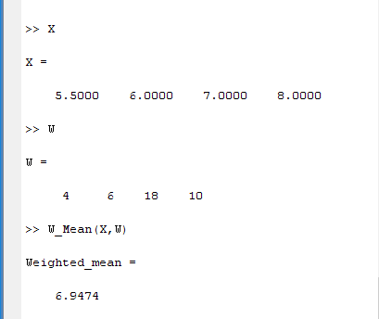
Output of Weighted Mean

Slide 8
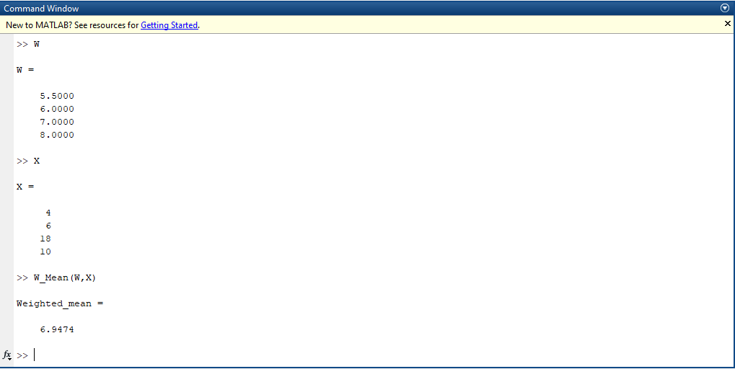
M. Amas Waseem

Slide 9
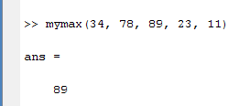
Function
You can call the function as :
mymax(34, 78, 89, 23, 11)
Output:

Slide 10
Exercise Question
Question: 1
(Create Weighted Mean Function)
Compute the grade point average for a student whose course record is given:
Courses | Grade | Grade Point | Hours
Statistics | C | 2 | 4
Mathematics | A | 4 | 3
Physics | B | 3 | 3
Islamic studies | A | 4 | 2

Slide 11
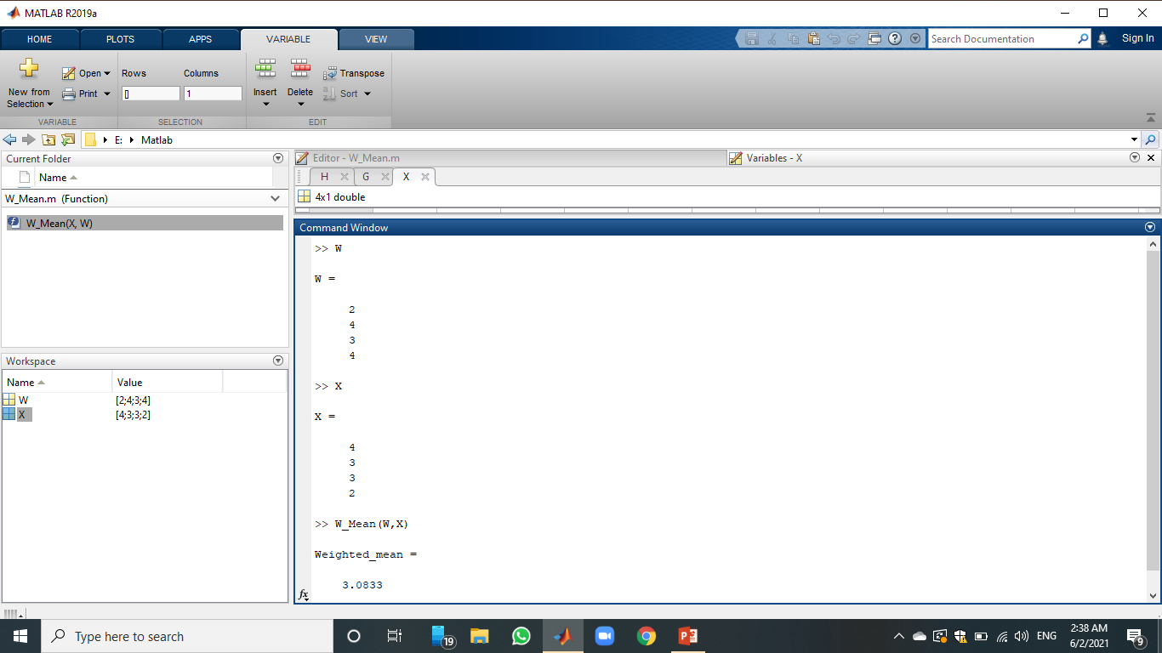
M. Amas Waseem

Slide 12

Arithmetic Mean for Grouped Data
Example: calculate Arithmetic mean from following frequency distribution.

Slide 13
Function
function [mean] = Function_Mean(L,U,F)
X = (L+U)/2;
FX= F.*X;
sum_f=sum(F);
sum_fx=sum(FX);
mean=sum_fx/sum_f;
end

Slide 14
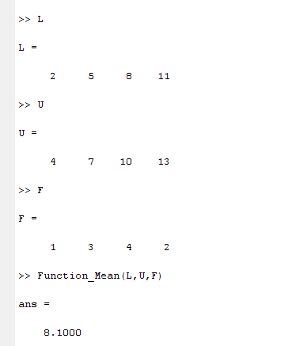
Function

Slide 15
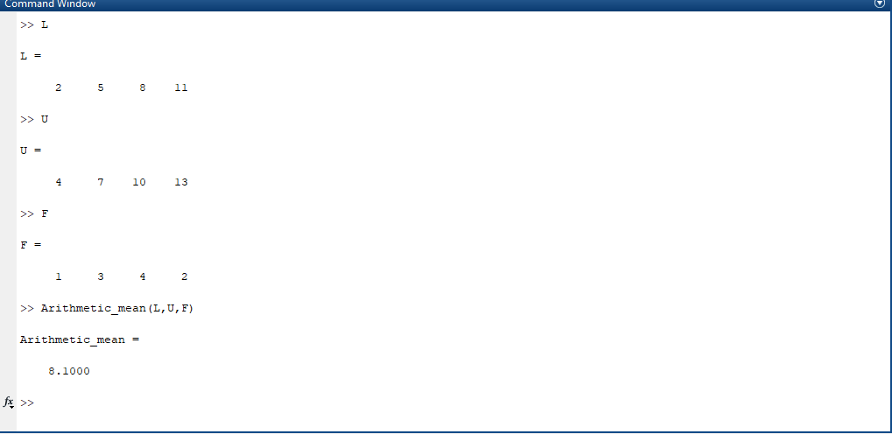
M. Amas Waseem

Slide 16
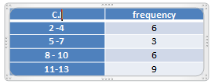
Exercise Question
Question: 1
Calculate Arithmetic mean from the following frequency distribution:

Slide 17
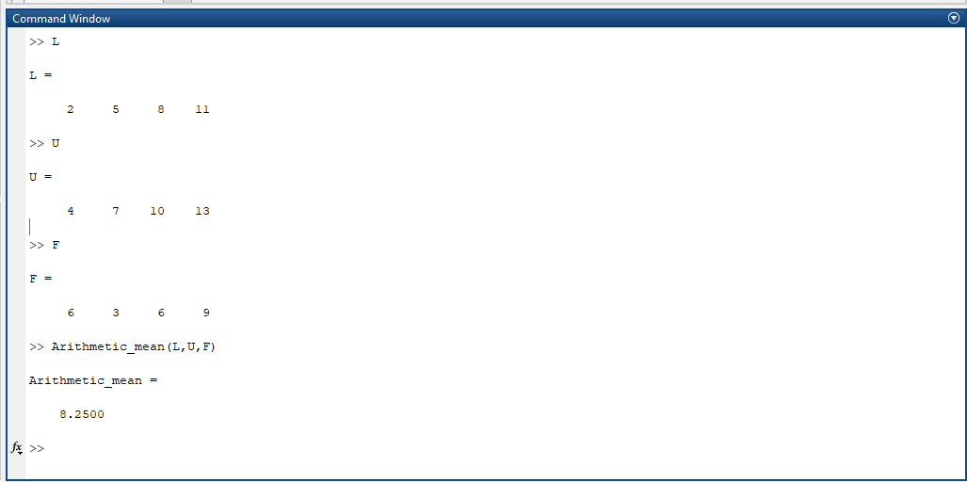
M. Amas Waseem

Slide 18
Exercise Question
Question: 2
Calculate Arithmetic mean from the following frequency distribution
C.I | F
50-54 | 1
55-59 | 6
60-64 | 11
65-69 | 16
70-74 | 21
75-79 | 11
80-84 | 7
85-89 | 5

Slide 19
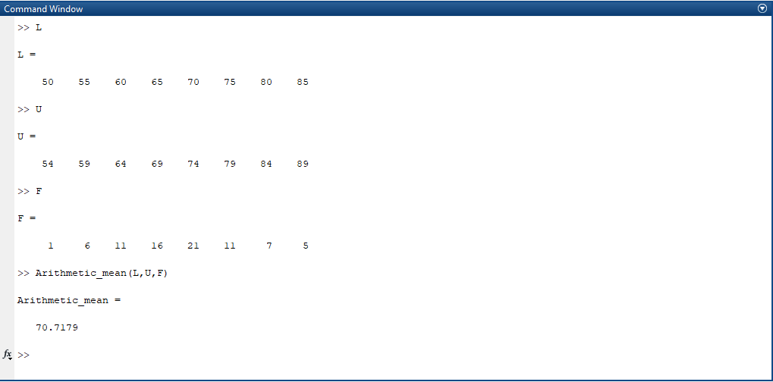
M. Amas Waseem

Slide 20
Mode
Example:
Calculate mode for the following frequency distributions:
C.I | 2-4 | 5-7 | 8-10 | 11-13 | 14-16
F | 2 | 6 | 11 | 4 | 1

Slide 21
Function
function [] = Function_Mode(L,U,F)
[i,j]=max(F); % i=11 ; j=3(index value)
fm=i; % max freq : fm=11
f1=F(j-1); % f1=preceding freq (3-1)=6
f2=F(j+1); % f2=next freq(3+1)=4
i=L(j); % i=8
l=i-0.5;
h1=(U-L); //h1=[ 2 2 2 2 2]
h=h1(:,1);
h=h+1;
Mode=l+(fm-f1)/(2*fm-f1-f2)*h
end

Slide 22
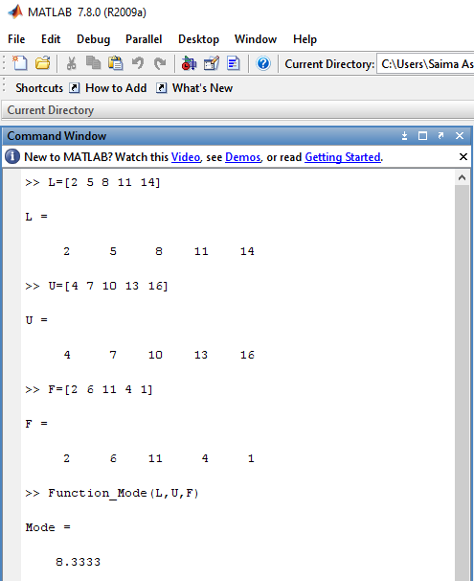
Output

Slide 23
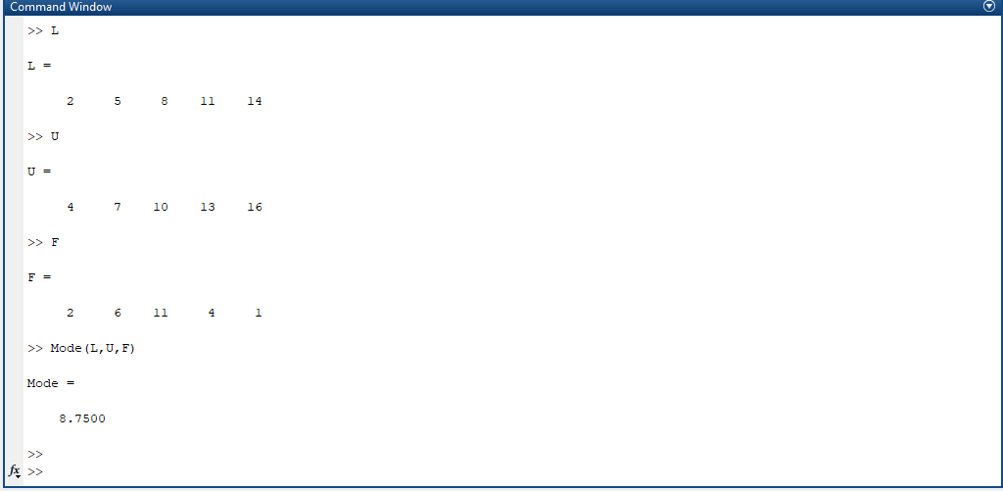
M. Amas Waseem

Slide 24
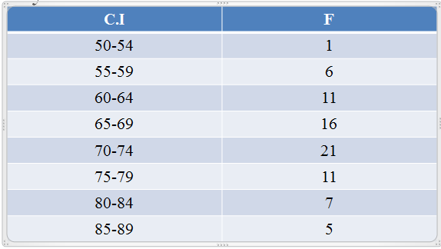
Exercise Question
Question: 1
Calculate Arithmetic mode from the following frequency distribution

Slide 25
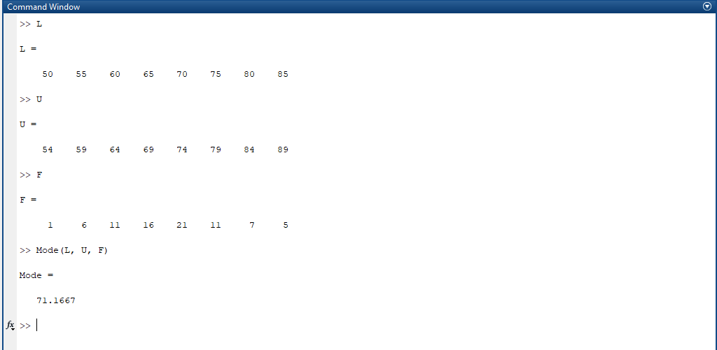
M. Amas Waseem

Slide 26
EXERCISE QUESTION
FUNCTION :-
Median for Grouped Data
Solve one example from Register .

Slide 27
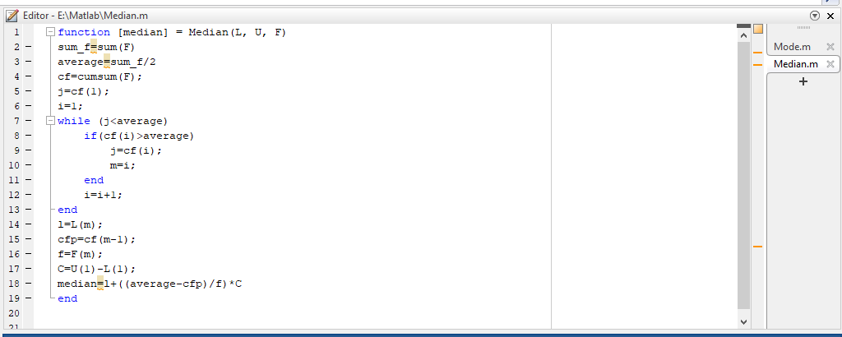
M. Amas Waseem

Slide 28
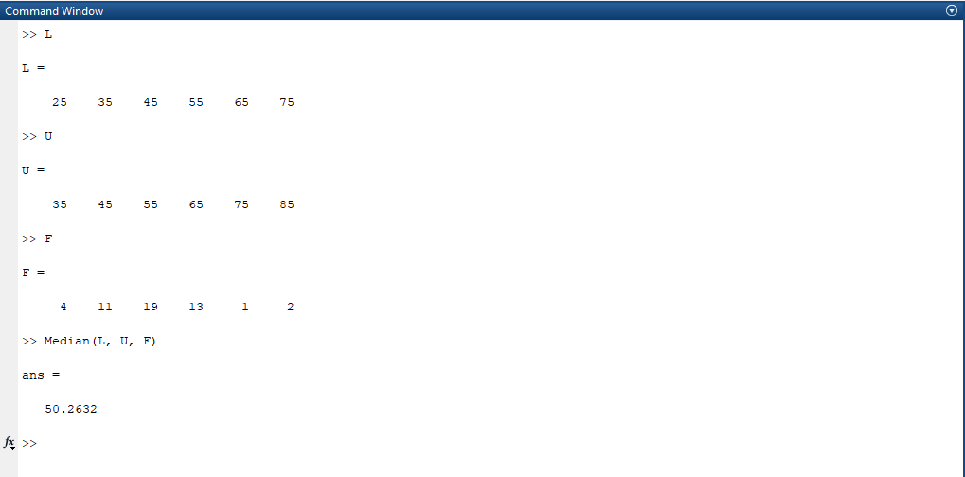
M. Amas Waseem

